Slide 1
Investigation of cis and trans features associated with intron retention (IR)
Data Collection
Gather CLIP and RNA-Seq data from many studies, upload to Flow, and uniformly analyse
Exploratory Analysis
Use VastDB expression data from 145 cell lines and tissue types to probe all IR events
Prediction
Feed IR events to RBPnet to predict binding over introns + 50 nt flanks, look for correlation with splicing score (PSI), cryptic splice sites from SpliceAI
Calculate
Calculate an “intron retention propensity” score for all human introns
Model
Build Machine Learning model with tidymodels R package, testing for optimised hyperparameter search from mixed feature types
https://github.com/ulelab/intron_retention_propensity

Slide 2
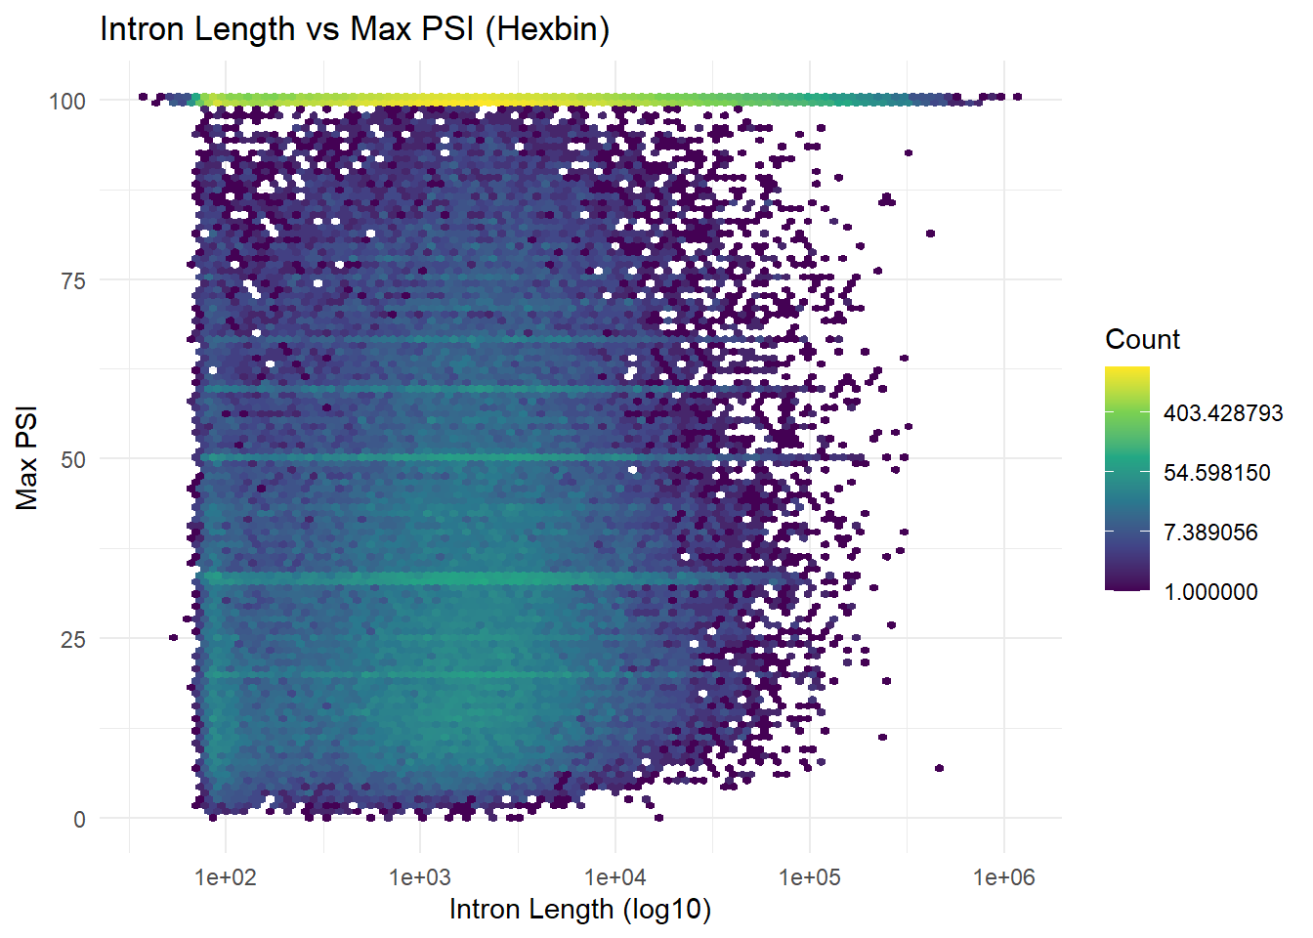
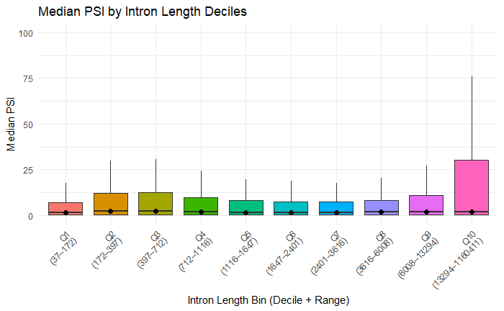
192965

Slide 3
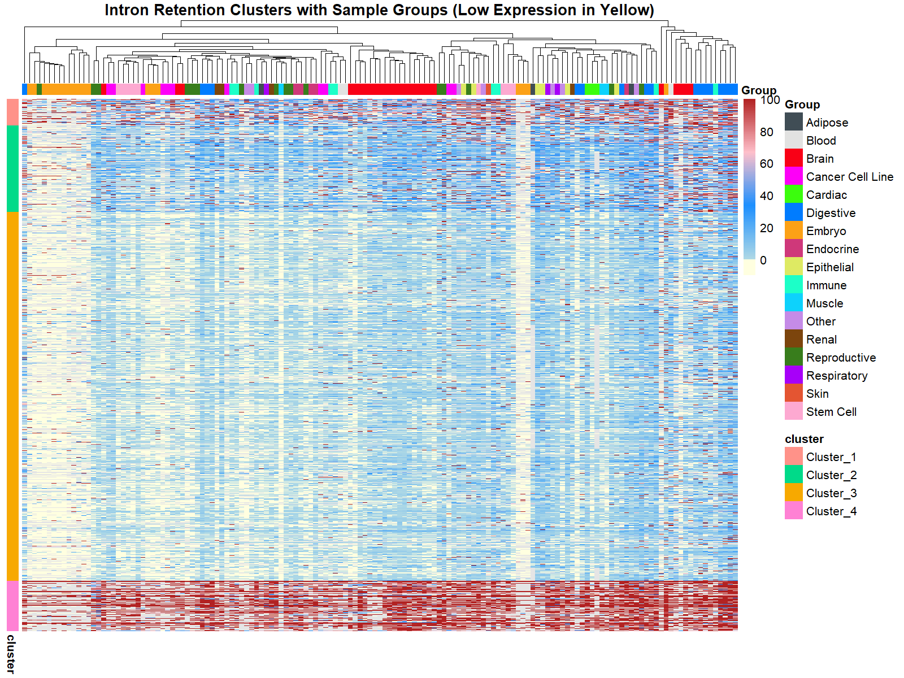

Slide 4
